Slide 1
RGB vs. HSB colorMode
Mr Mack 2021

Slide 2
Overview
In this learning activity students add color to the drawing they made in activity 1. They learn to apply the background, fill, and strokefunctions (used in scales of gray until now), to define colors and add transparency. Both the RGB (Red, green, blue) and HSB (Hue, Saturation, Brightness) color models are applied.
Students apply the programming concepts they learned in the previous unit (variables, randomness) to color manipulation, defining color ranges and palettes.

Slide 3
Objectives
Students will be able to:
explain and utilize the HSB color mode.
understand the differences between RGB and HSB color modes.

Slide 4
HSB Color
HSB is an alternative color space to RGB. In this model, colors are described by their hue, saturation, and brightness:
Hue is expressed in degrees, from red(0), through all the colors around the color wheel, and back to red (360).
Saturation is the amount of color, and ranges between 0 and 100.
Brighness the amount of light, ranging between 0 and 100. The alpha channel goes from 0 (not visible) to 1 (fully opaque).

Slide 5
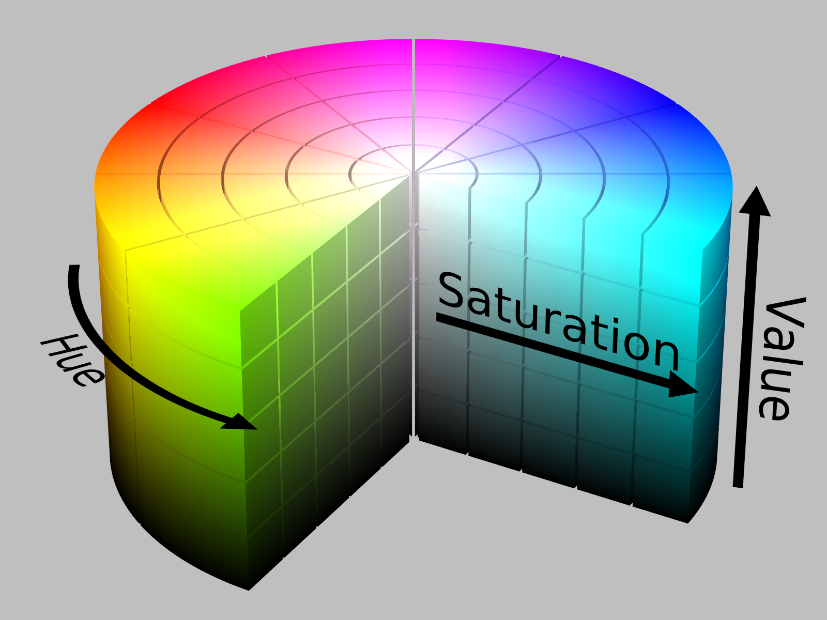
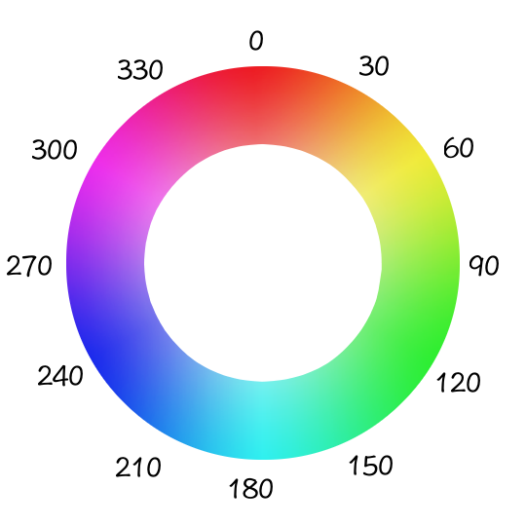
HSB Color

Slide 6

HSB Color
To have p5 use HSB instead of RGB, we call colorMode(HSB). Here is the same example from above, using the HSB color mode instead of RGB. Notice how the colors red, green and blue are defined differently now: in RGB, red is defined by (255, 0, 0); in HSB, it is (360, 100, 100).

Slide 7
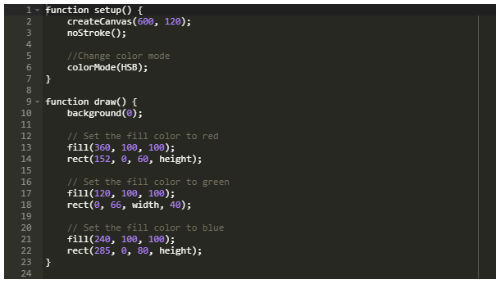
HSB Color

Slide 8
HSB Color
HSB makes it easier to define color ranges that fit descriptions like these, which would be harder to accomplish using RGB:
A dark, muted red. For red, we might set the Hue to be somewhere between 350 and 360. To make it dark, we can set Brightness to be between 30 and 50. A Saturation between 20 and 40 will make it muted.
A light, vibrant blue. What Hue, Saturation and Brightness ranges would you choose to get a color that fits this description?

Slide 9
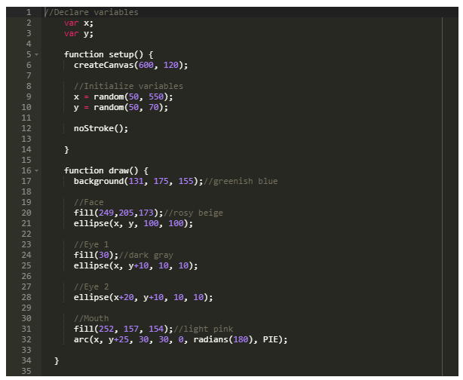

HSB Color
Notes:
Now define an HSB color palette and apply it to a drawing from the previous activities.

Slide 10
Color Palettes
As you'll be using color often, you may want to familiarize yourself with color terms and different palettes that are pleasing to the eye. You should be familiar with the following:
Color palette - in the digital world, refers to the full range of colors that can be displayed on a device screen or other interface,
Primary Color - any of a group of colors from which all other colors can be obtained by mixing.
Secondary Color - a color resulting from the mixing of two primary colors.

Slide 11
Color Palettes
Accent Color - are colors that are used for emphasis in a color scheme.
Complementary Colors - colors directly opposite each other in the color spectrum, such as red and green or blue and orange, that when combined in the right proportions, produce white light.
Analogous Colors - groups of three colors that are next to each other on the color wheel, sharing a common color, with one being the dominant color, which tends to be a primary or secondary color, and a tertiary. Red, orange, and red-orange are examples.
If you're not sure how to start organizing your color palette, try using Adobe Color Picker or Paletton!

